Slide 1


SAP BTP CPI Training

Slide 2

DISCLAIMER
The training content and delivery of this presentation is confidential, and cannot be recorded, or copied and distributed to any third party, without the written consent of Anubhav Trainings

Slide 3


Introduction

Slide 4

LEARNING OBJECTIVES
Introduction to BTP
On premise v/s Cloud offerings
Integration
What cloud offers
What is SAP BTP?
What BTP offers
BTP setup
Differentiate Between On-premise v/s Cloud
Explain Why SAP Cloud Platform is Used
Describe How to Setup your SAP Cloud Trial Ac

Slide 5

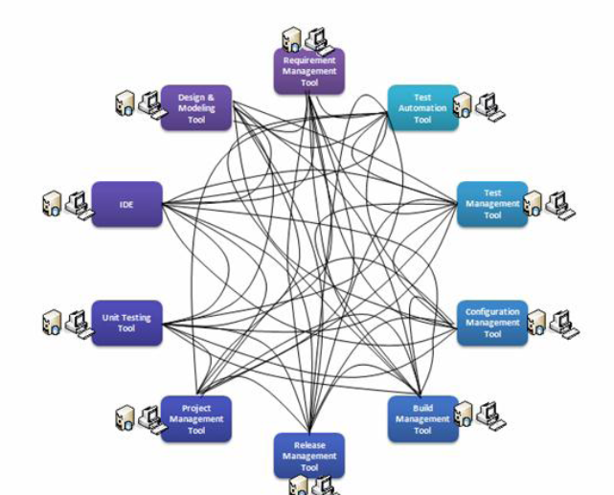

Integration
OLD INTEGRATION
www.anubhavtrainings.com
Notes:
https://help.sap.com/docs/BTP/65de2977205c403bbc107264b8eccf4b/144e1733d0d64d58a7176e817fa6aeb3.html

Slide 6
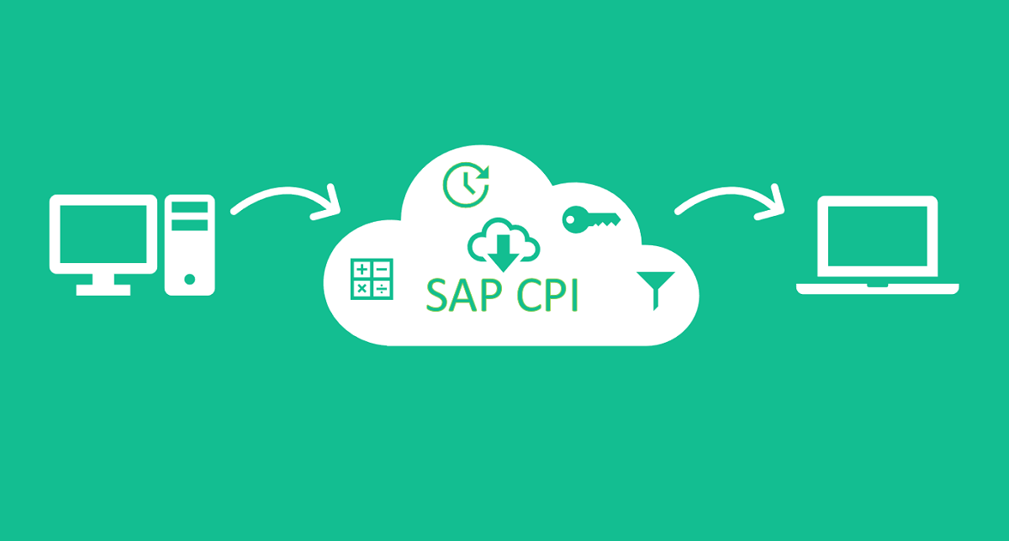
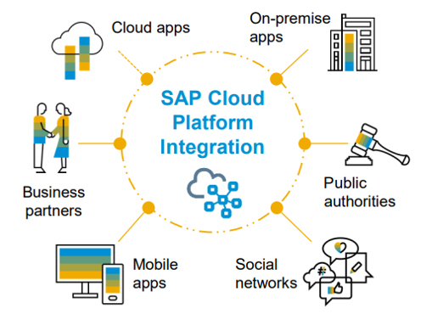
SAP Cloud Integration
OLD ITEGRATION
www.anubhavtrainings.com
Notes:
https://help.sap.com/docs/BTP/65de2977205c403bbc107264b8eccf4b/144e1733d0d64d58a7176e817fa6aeb3.html

Slide 7

SAP Cloud Integration
CASE 1
Source
Target
<Root>
<Name>Dummy</Name>
</Root>
OLD ITEGRATION
{
"Root": {
"Name": "Dummy"
}
}
www.anubhavtrainings.com
Notes:
https://help.sap.com/docs/BTP/65de2977205c403bbc107264b8eccf4b/144e1733d0d64d58a7176e817fa6aeb3.html

Slide 8
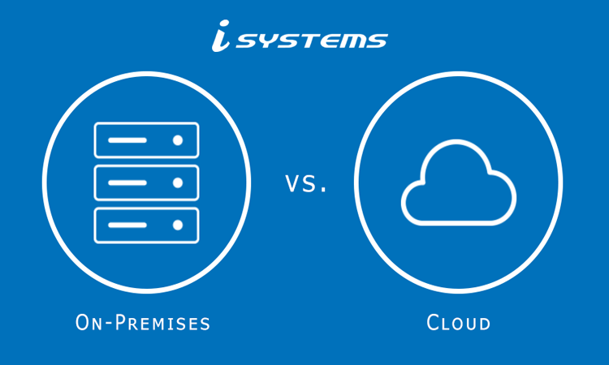
System
www.anubhavtrainings.com
Notes:
https://help.sap.com/docs/BTP/65de2977205c403bbc107264b8eccf4b/144e1733d0d64d58a7176e817fa6aeb3.html

Slide 9
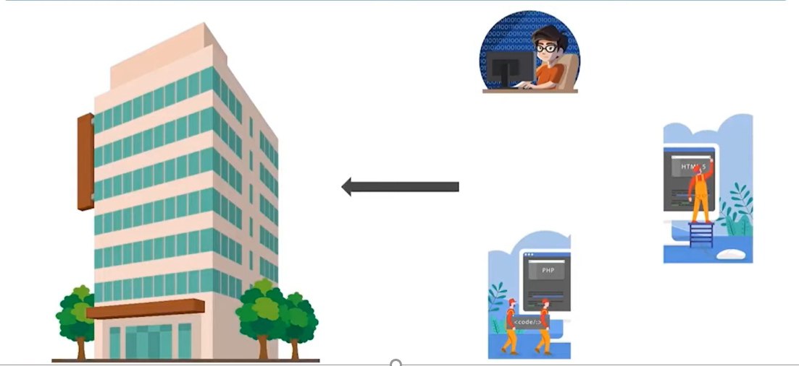
ON premise Architecture ON premise Architecture On premise Architecture
www.anubhavtrainings.com
Notes:
https://help.sap.com/docs/BTP/65de2977205c403bbc107264b8eccf4b/144e1733d0d64d58a7176e817fa6aeb3.html

Slide 10
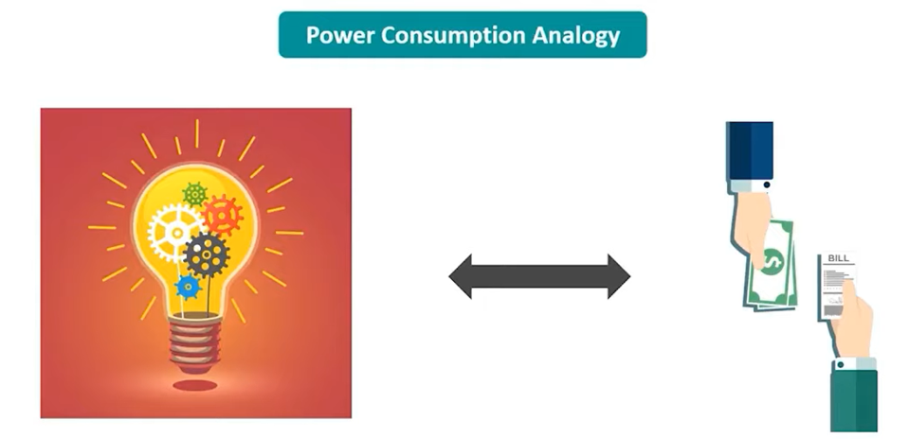
Cloud Computing
www.anubhavtrainings.com
Notes:
https://help.sap.com/docs/BTP/65de2977205c403bbc107264b8eccf4b/144e1733d0d64d58a7176e817fa6aeb3.html

Slide 11
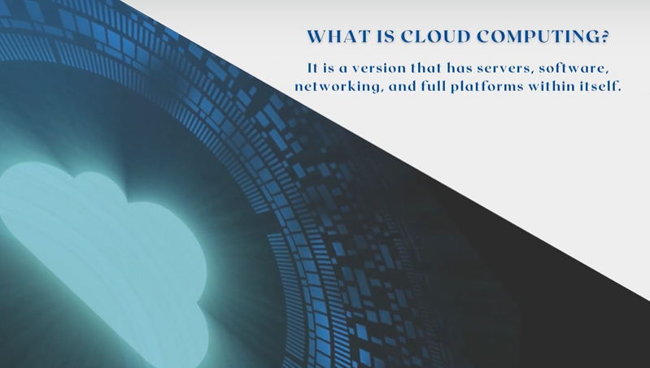
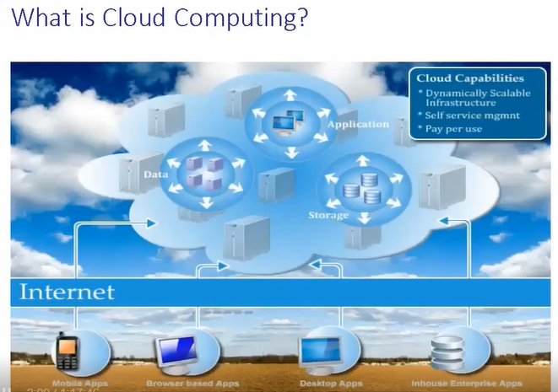
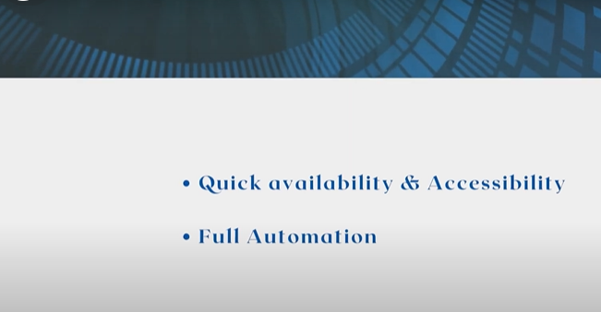
Cloud Computing
www.anubhavtrainings.com
Notes:
https://help.sap.com/docs/BTP/65de2977205c403bbc107264b8eccf4b/144e1733d0d64d58a7176e817fa6aeb3.html

Slide 12
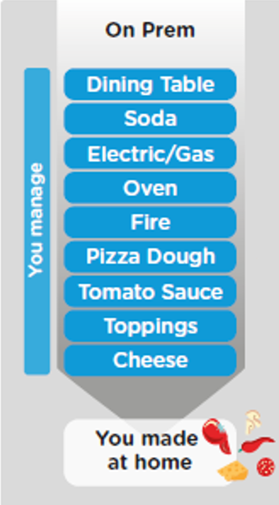
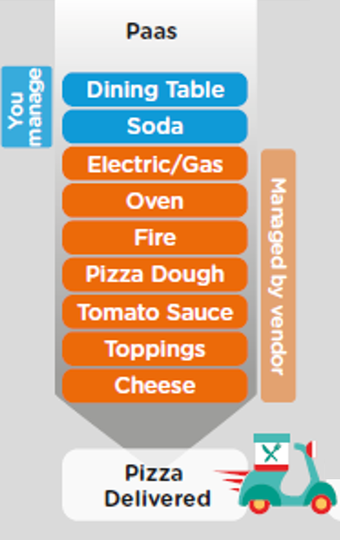
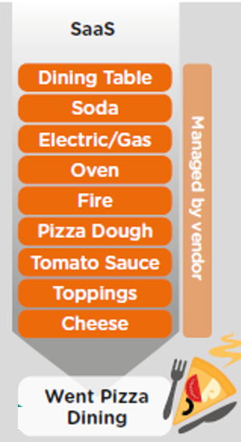
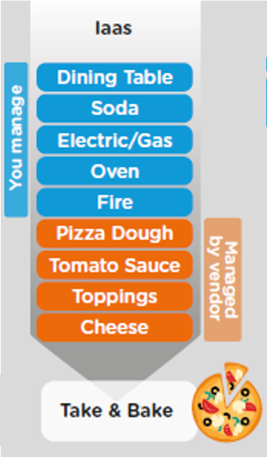
On Premise V/s Cloud
www.anubhavtrainings.com

Slide 13
Types of Cloud Offerings
Content
Application
Application As a Service
Customer Managed
Customer Managed
Customer Managed
SAP Managed
Data
Runtime
Platform as a Service
SAP/Partner Managed
Middleware
Database
OS
Virtualization
Infrastructure as a Service
SAP/Partner Managed
Servers
Storage
Networking
www.anubhavtrainings.com

Slide 14
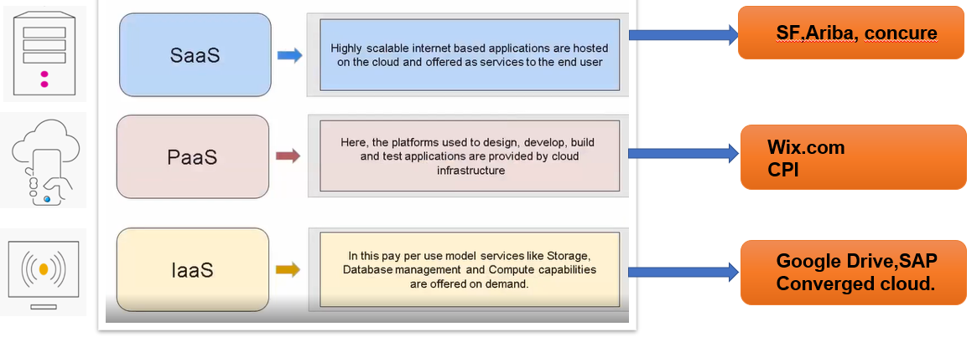
Cloud Computing Models
www.anubhavtrainings.com

Slide 15




What is BTP
Application
Application
Data
Data
Runtime
Platform as a Service
Managed by SAP implementing open source CF
Middleware
Fully ready landscape with reusable services
Scalability
Elasticity
Low TCO
Database
OS
Managed by Infrastructure
providers
Data Centers
Service Portfolio
Virtualization
Infrastructure as a Service
Servers
Storage
Networking
www.anubhavtrainings.com

Slide 16
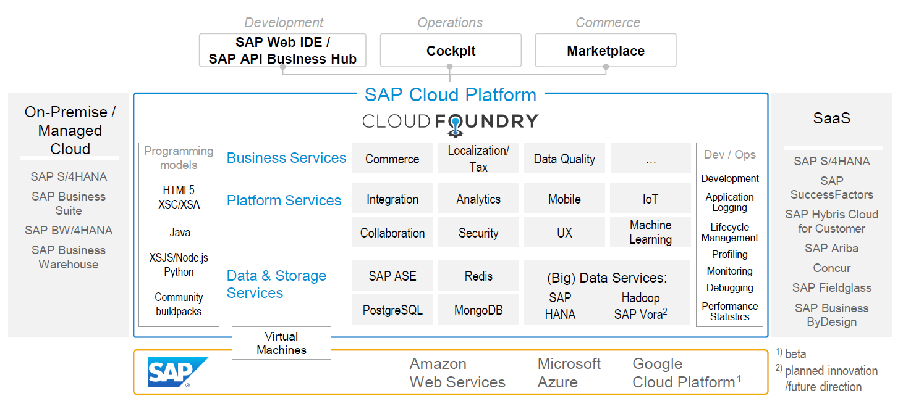
SAP CLOUD FOUNDRY ARCHITECTURE
SAP Business Application Studio

Slide 17
Environment, Subscriptions & Instances
Environments
Environments constitute the actual platform-as-a-service offering of SAP BTP that allows for the development and administration of business applications. Environments are anchored in SAP BTP on subaccount level.
SAP BTP offers three environments: ABAP, Cloud Foundry and Kyma. Some existing customers still have Neo, but this is no longer offered.
Subscription based services
You will also see these ones called software as a service (SaaS), or multitenant applications. The experience here is that you subscribe to the service, and in return you receive a URL, from which you can access that service. Opening the URL brings you to a web application from which you can leverage the service. This is how other SaaS like SuccessFactors or S/4HANA Cloud work as well. They are also enabled at a subaccount level, and are independent of the environments. You don’t need to have Cloud Foundry enabled to subscribe to SAP Launchpad Service, for example.
Examples include Launchpad, SAP Business Application Studio, Cloud Integration, Process Automation…
Instance based services
These are the purest services. They provide a specific functionality, like databases, connectivity, authentication…. You connect your application to them to leverage that functionality. These services don’t provide a UI to manage them. Instead, they rely on API to connect to applications and other services and provide their services. They are provisioned inside an environment, so they are environment specific. Each environment has its own organization (for users and applications): In Cloud Foundry, instances are created inside a space. For Kyma, instances are created inside a namespace.
www.anubhavtrainings.com
Notes:
https://help.sap.com/docs/BTP/65de2977205c403bbc107264b8eccf4b/144e1733d0d64d58a7176e817fa6aeb3.html

Slide 18
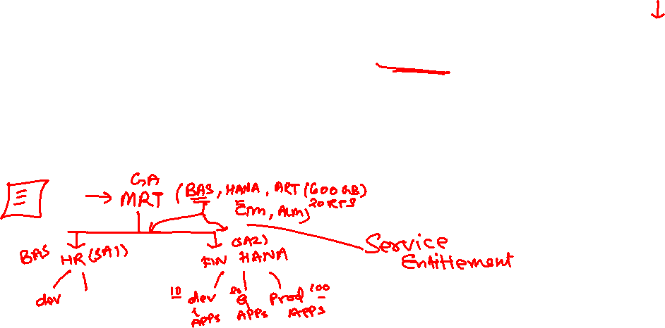
SETUP CLOUD PLATFORM ACCOUNT STRUCTURE
Backing Services
Global Account
(Representation of customer for billing purpose)
Sub Account
(per region)
Specialized service offerings
Represents LoB
Space quotas
1 *
1 *
Space
1
*
Apps

Slide 19
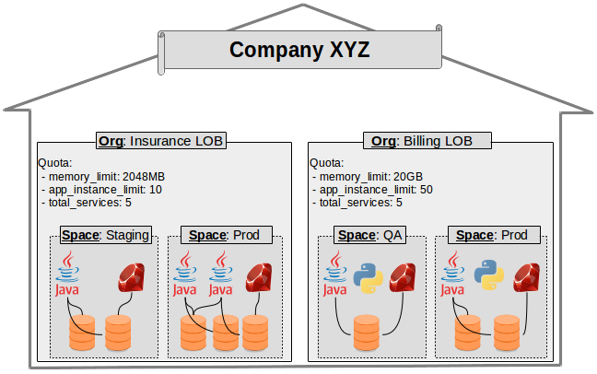
EXAMPLE – CF ORG STRUCTURE

Slide 20
SAP CPI Advantage
No maintenance
Less implementation time
Rolling software updates
Tenant Isolation
Light weight nature of CPI may be used in future for mobile based communication
Migration from SAP PI to SAP CPI
www.anubhavtrainings.com

Slide 21
SAP CPI vs PI
Cost
Availability
Prepackage
Support
Latest innovation
System setup
System Support
Latest updates
Monitoring
Data storage
Adapters
connectivity
www.anubhavtrainings.com

Slide 22
Integration Suit
SAP Integration Suite connects and contextualizes processes and data while enabling new content-rich applications to be assembled faster with less dependence on IT. Pre-built integration packs along with existing investments can be composed to deliver new outcomes with less involvement by integration experts
This service runs in the SAP BTP, Cloud Foundry environment.

Slide 23
Integration Suit
Features:
Design and operate integration scenarios
Design, develop, and manage APIs
Enable connectivity of applications
Use integration packs
Simplify mapping implementation
Manage integrations with trading partners

Slide 24
Integration Suit
Capabilities
Cloud Integration- Integrate SAP and non-SAP, cloud, and on-premise applications and process messages in real-time scenarios spanning different companies, organizations, or departments within one organization
API Management
Open Connectors
ntegration Advisor
Trading Partner Management
Integration Assessment

Slide 25
What is CPI
Support end-to-end process integration through the exchange of messages.
SAP Cloud Integration helps you to connect cloud and on-premise applications with other SAP and non-SAP cloud and on-premise applications.
This service has the capabilities to process messages in real-time scenarios spanning different companies, organizations, or departments within one organization.

Slide 26
Features
Implement diverse scenarios
Connect to multiple endpoints
Customize SAP integration scenarios
Develop custom adapters
Access public APIs
Set up secure and reliable communication
Implement various communication modes
Integrate with SAP Process Orchestration

Slide 27
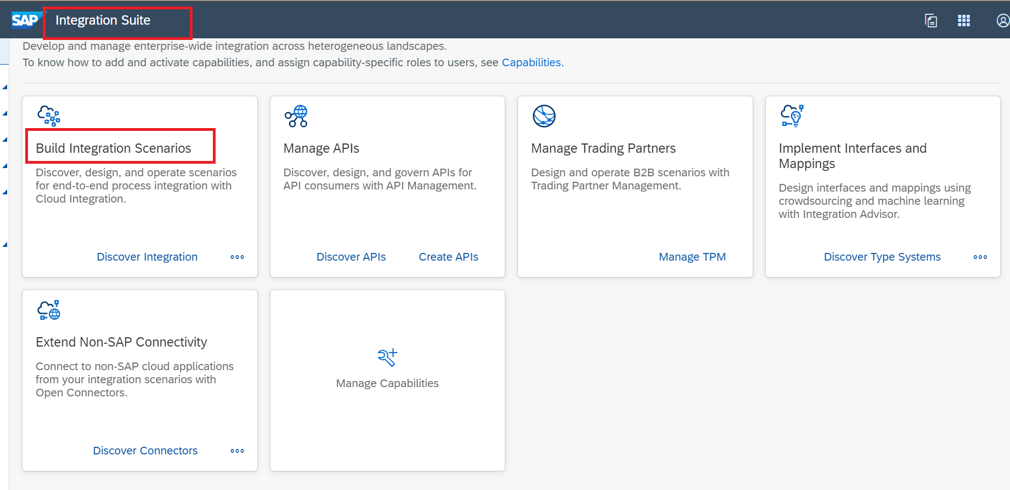
Integration Suit and SAP CI

Slide 28
Integraion Suit and SAP CI

Slide 29
Setup BTP TRAIL Account
In your web browser, open the SAP BTP trial cockpit- https://account.hanatrial.ondemand.com/

Slide 30
QnA
Difference Between IS and CI
Difference Between PI/PO and CPI
Difference between Onpremise and Cloud

Slide 31
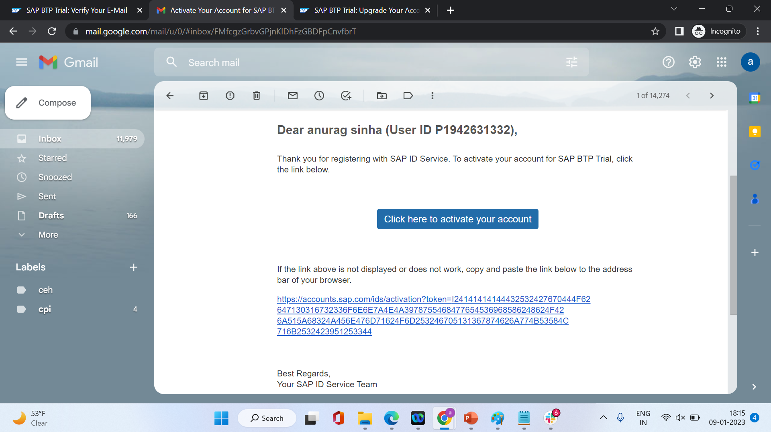

Slide 32
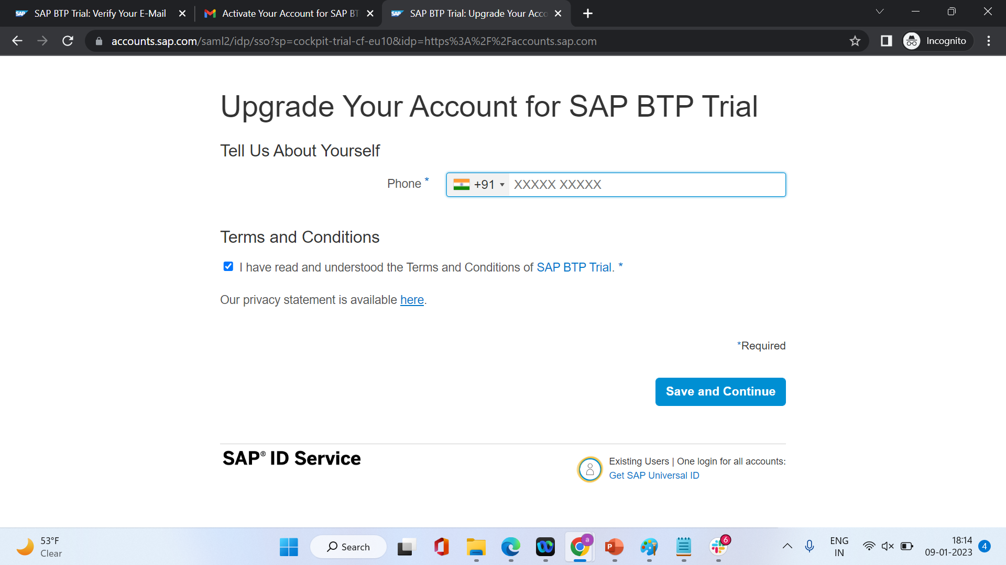

Slide 33
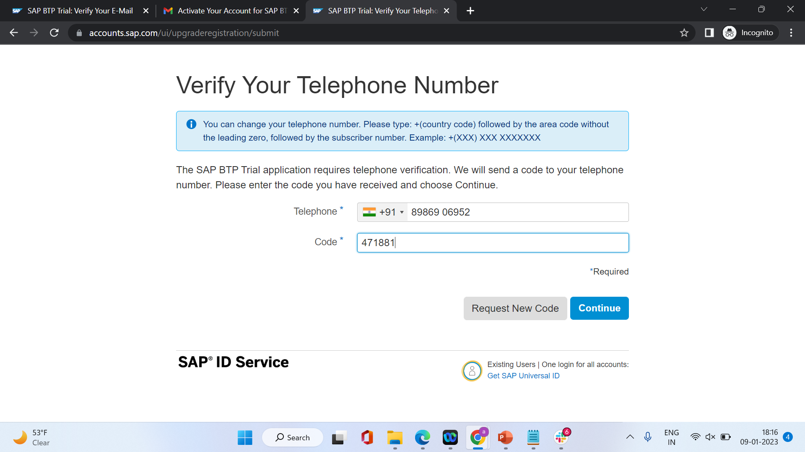

Slide 34
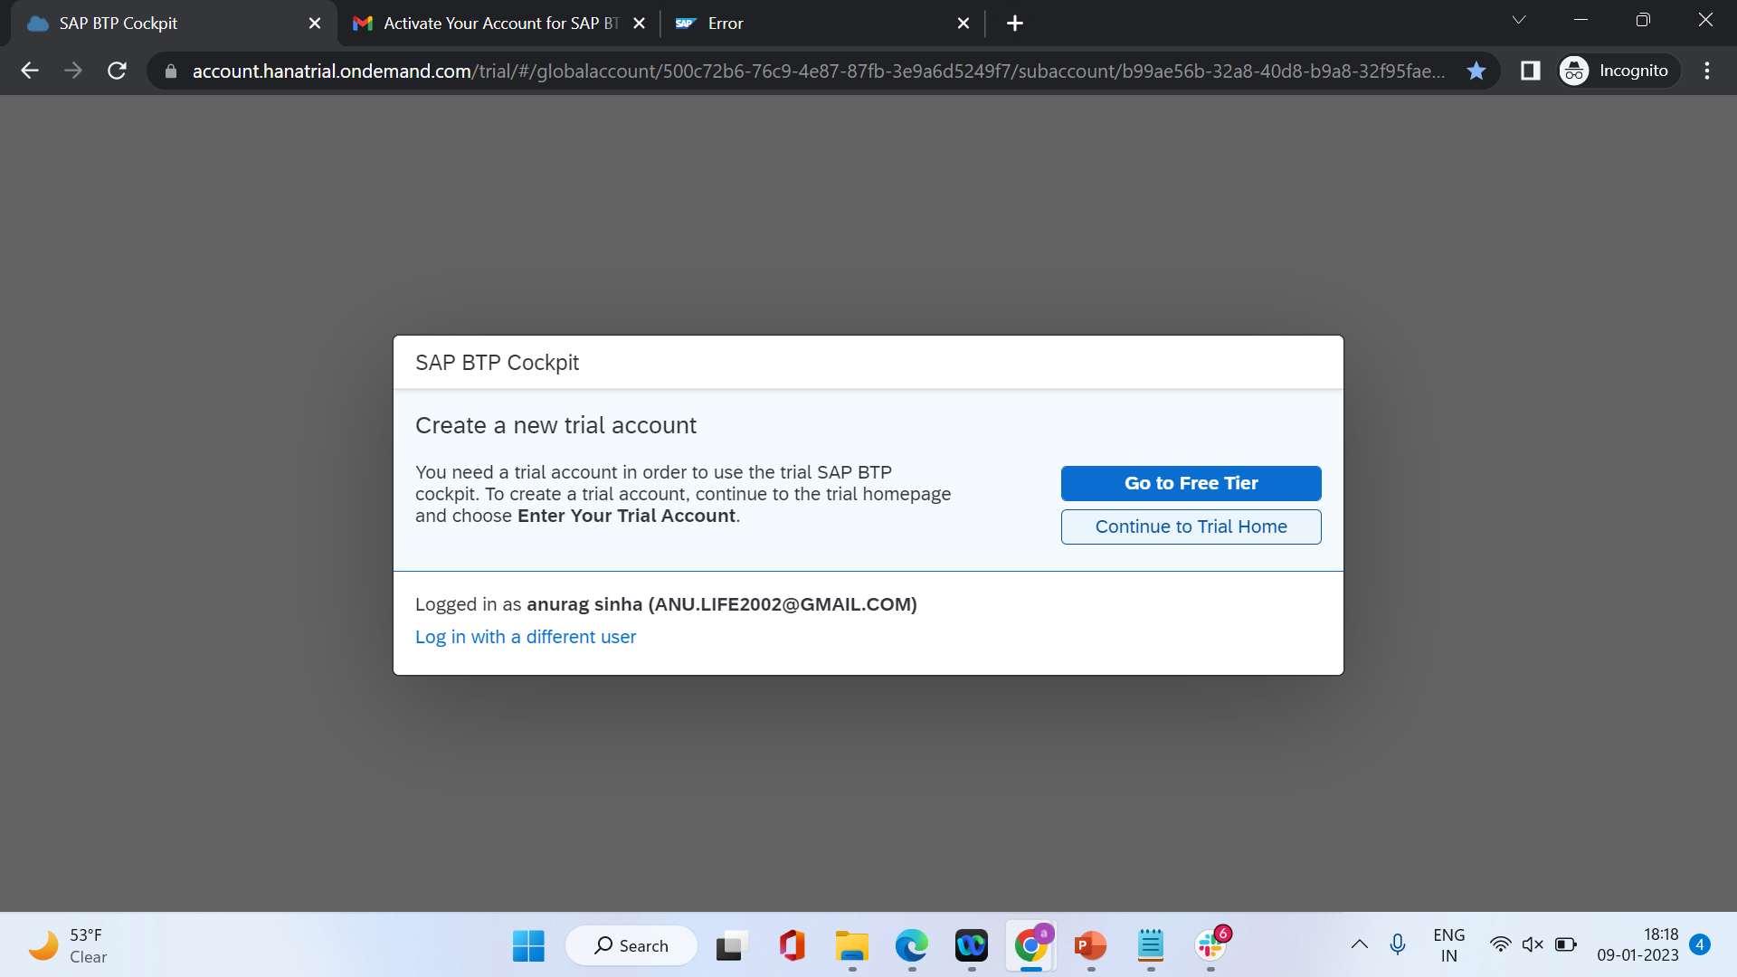

Slide 35
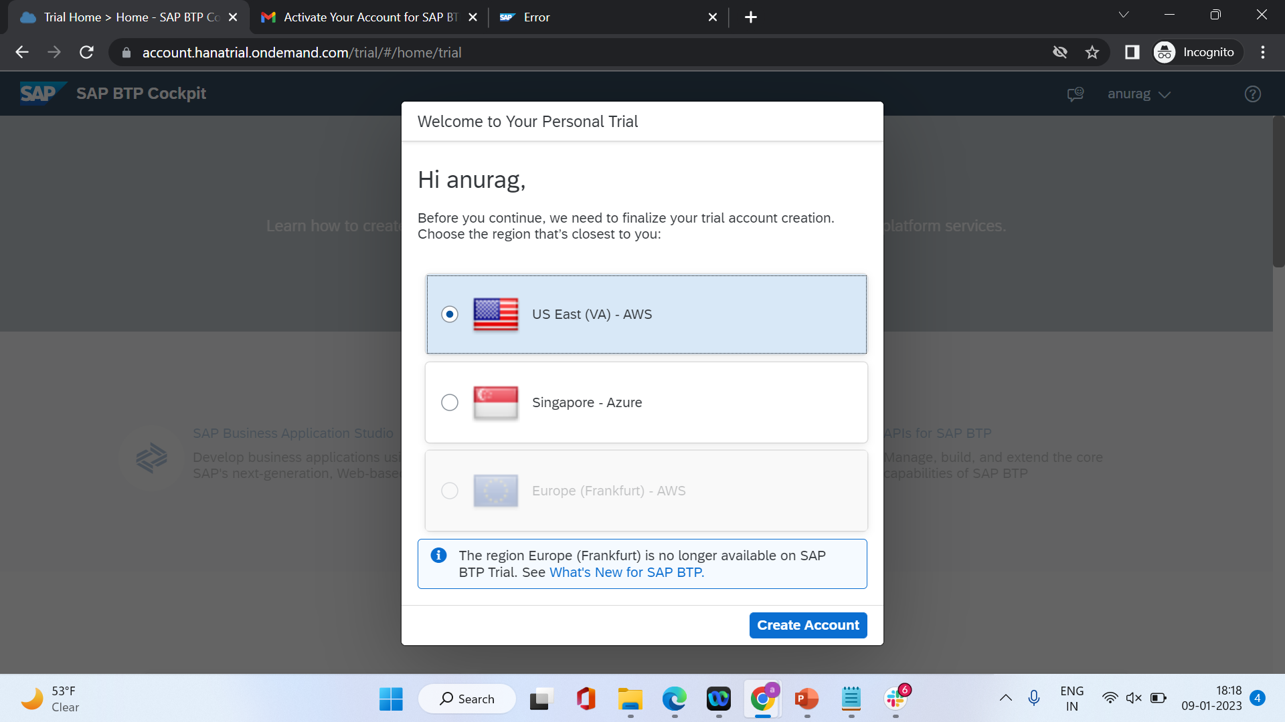

Slide 36
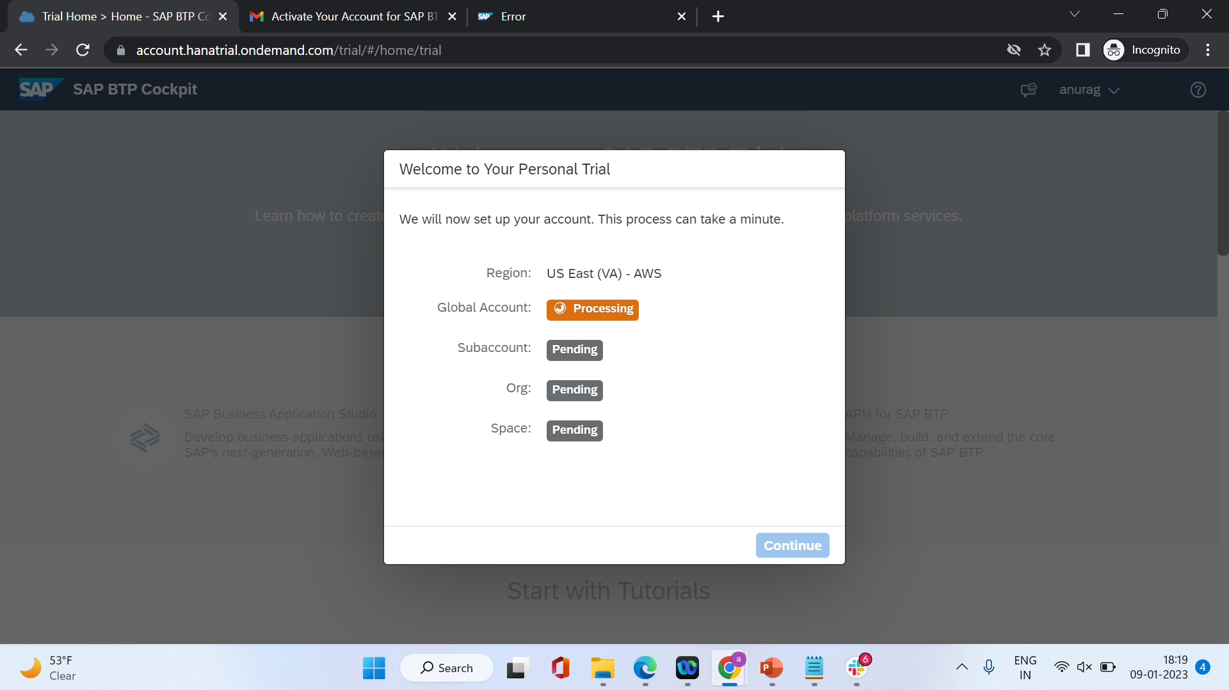

Slide 37
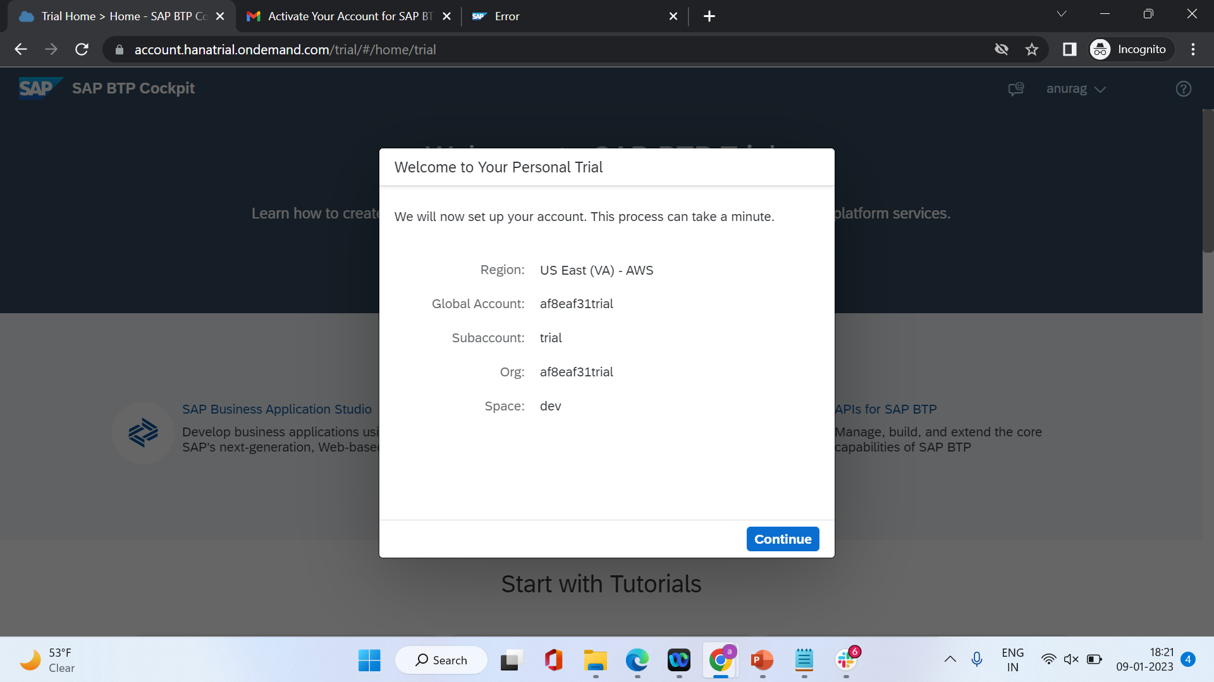

Slide 38
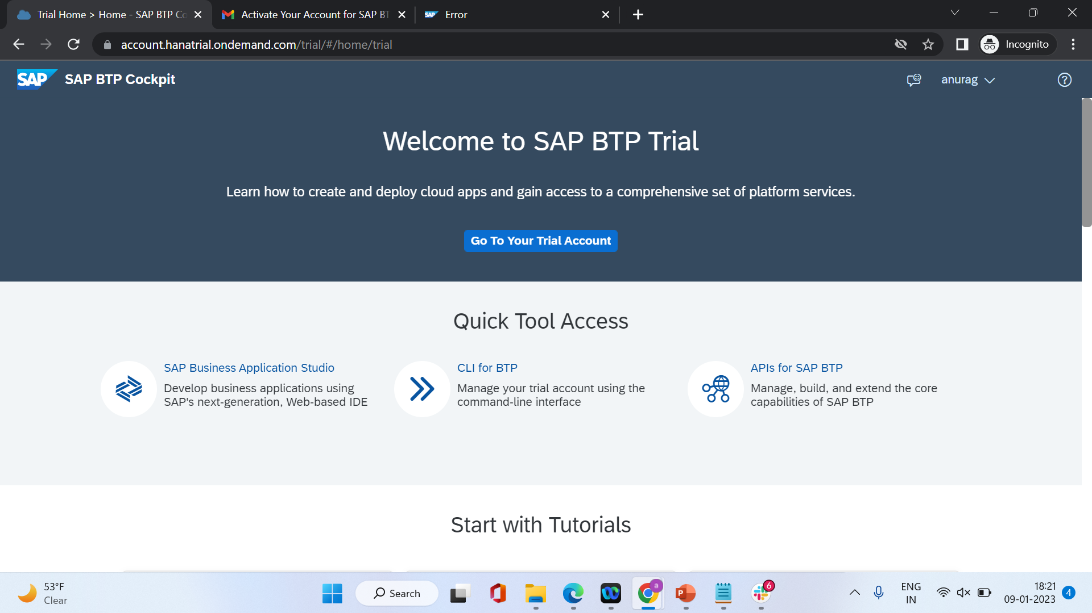

Slide 39
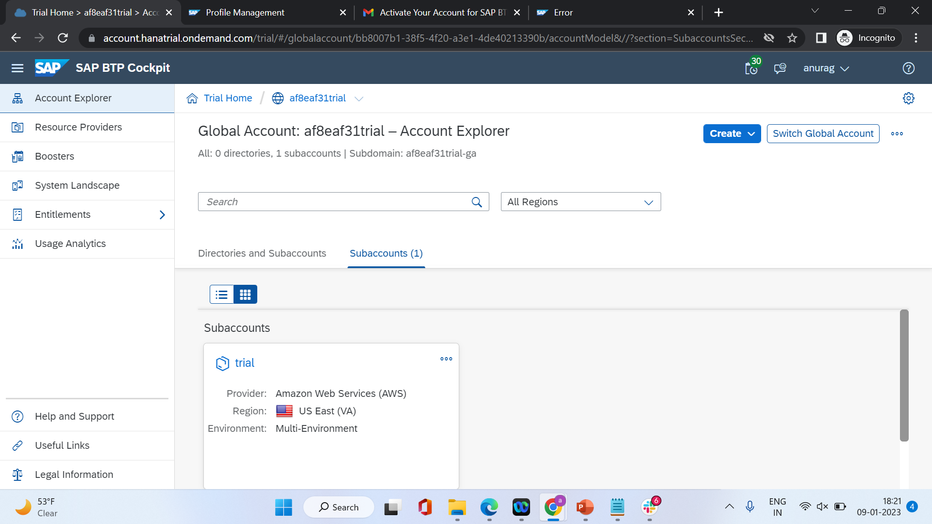

Slide 40
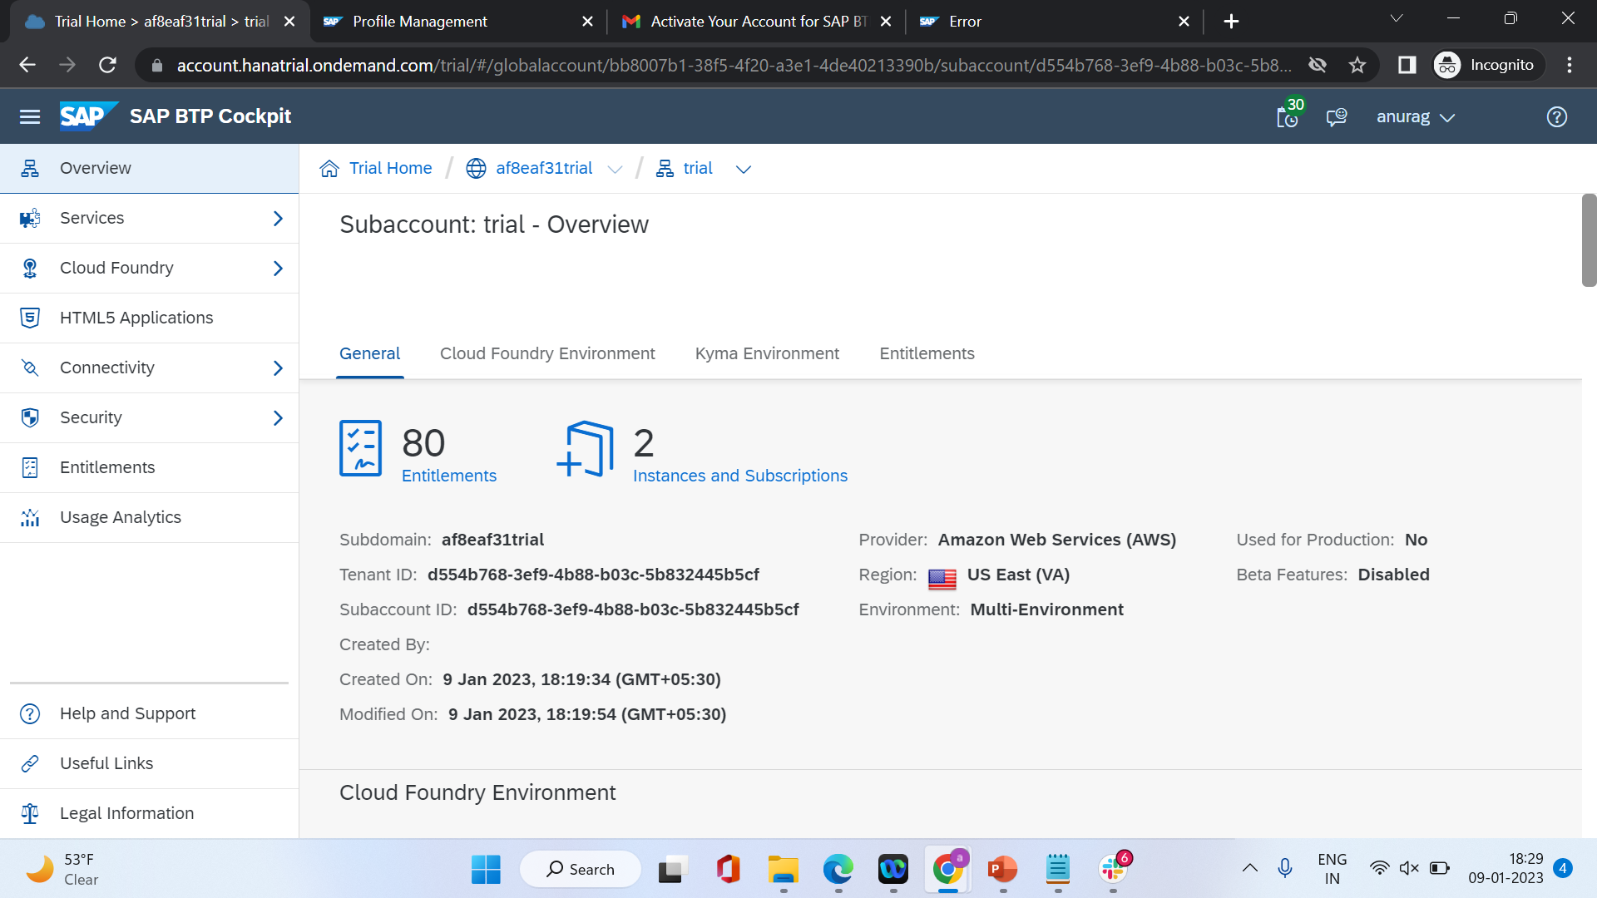

Slide 41
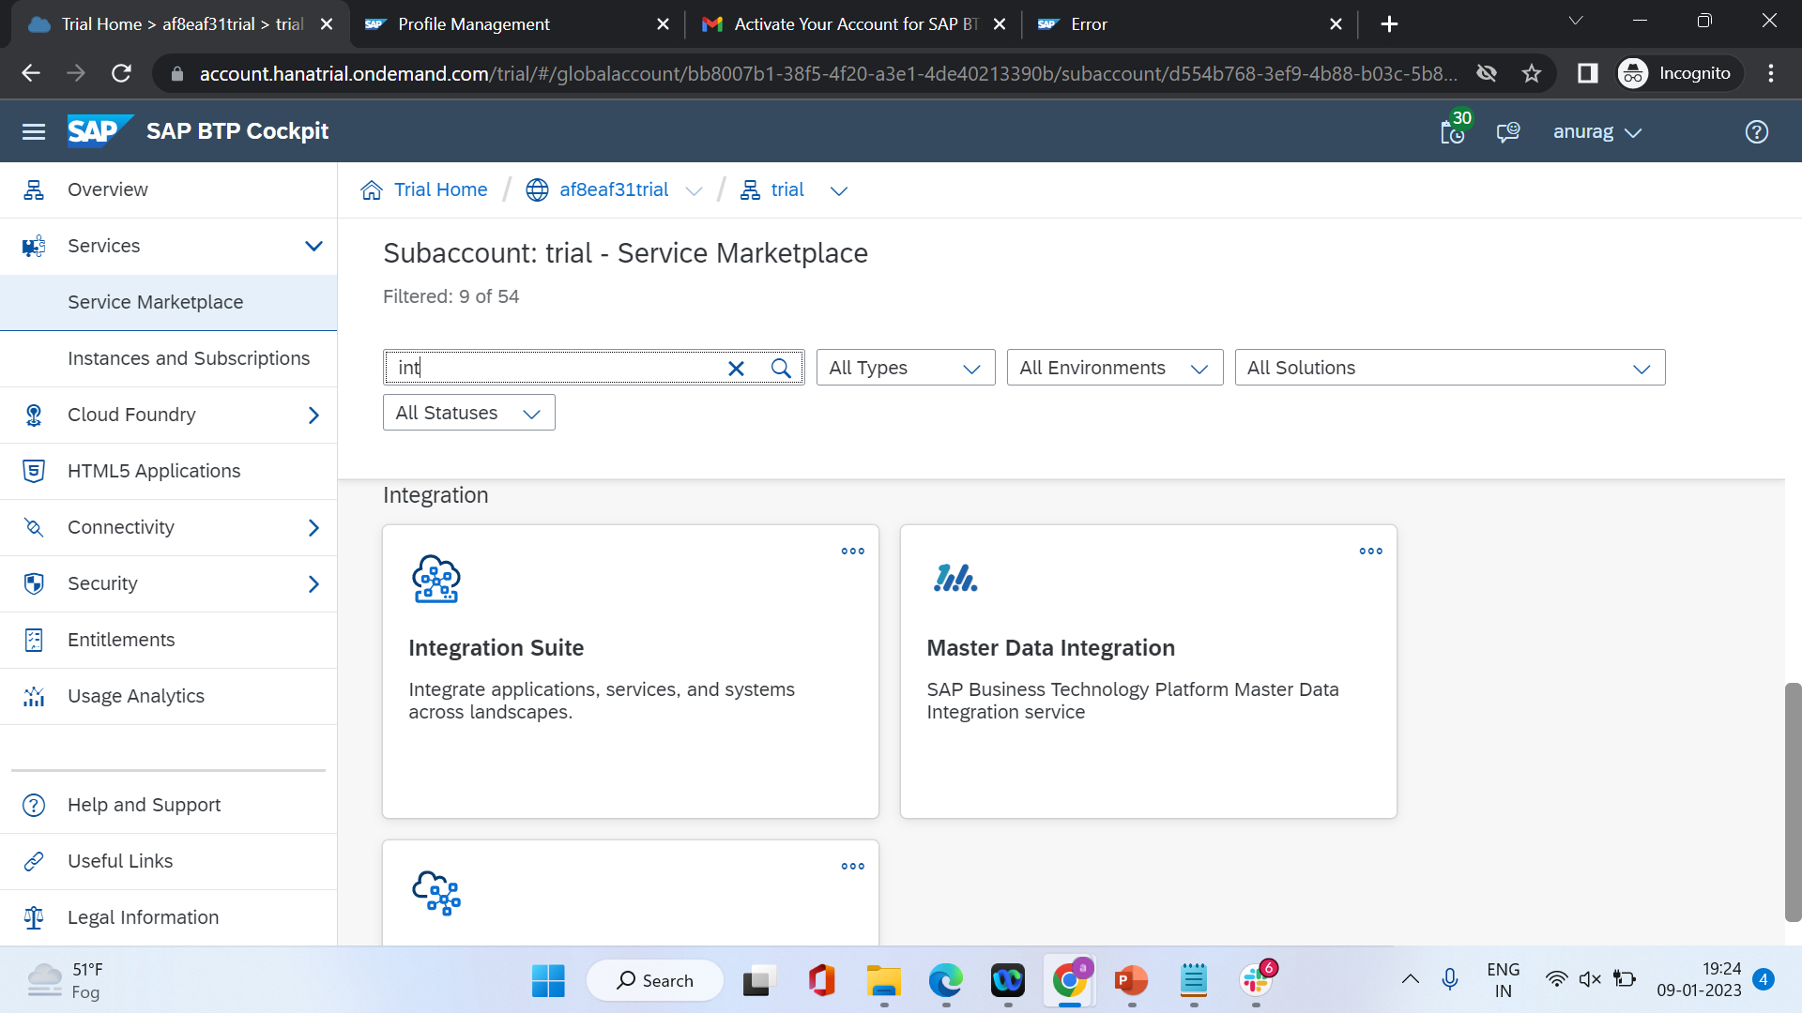

Slide 42
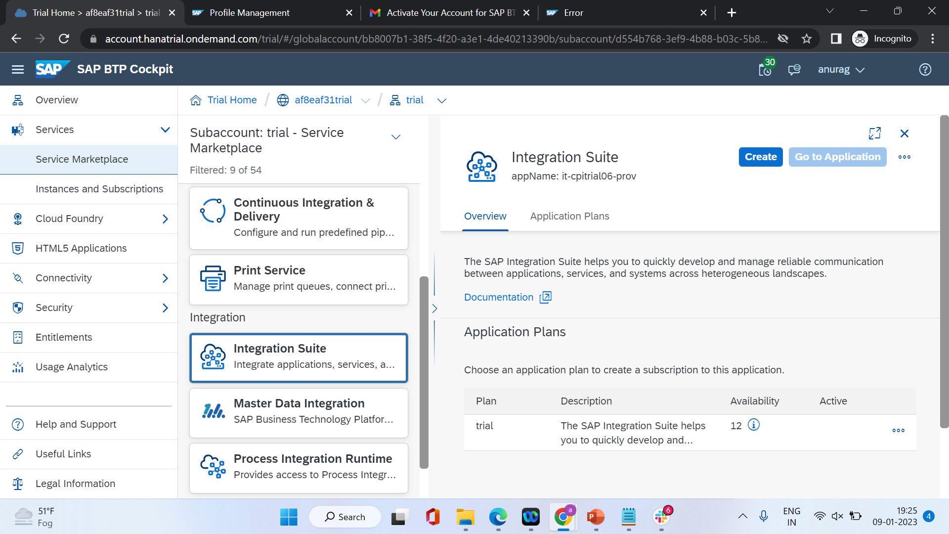

Slide 43


Slide 44
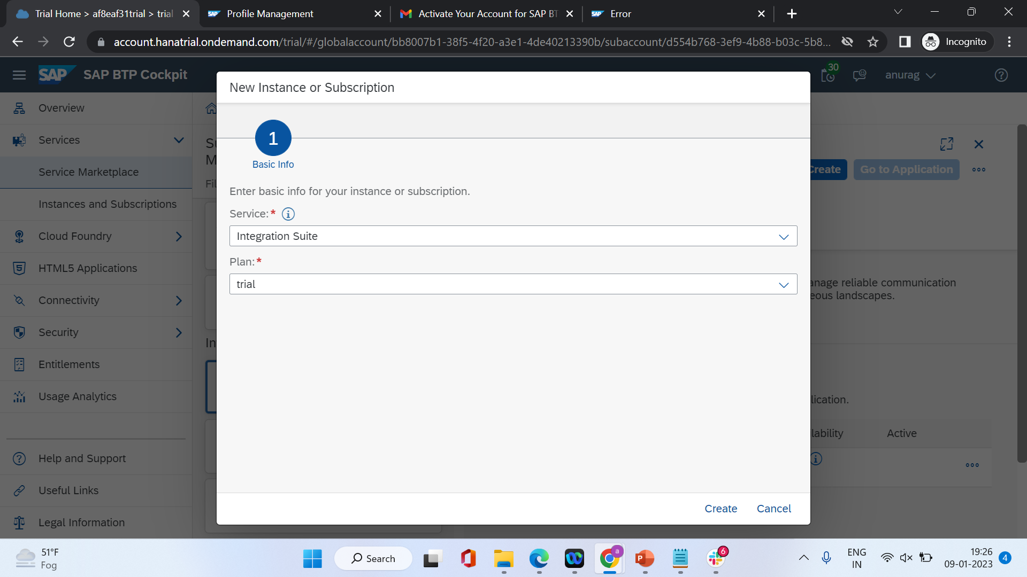

Slide 45
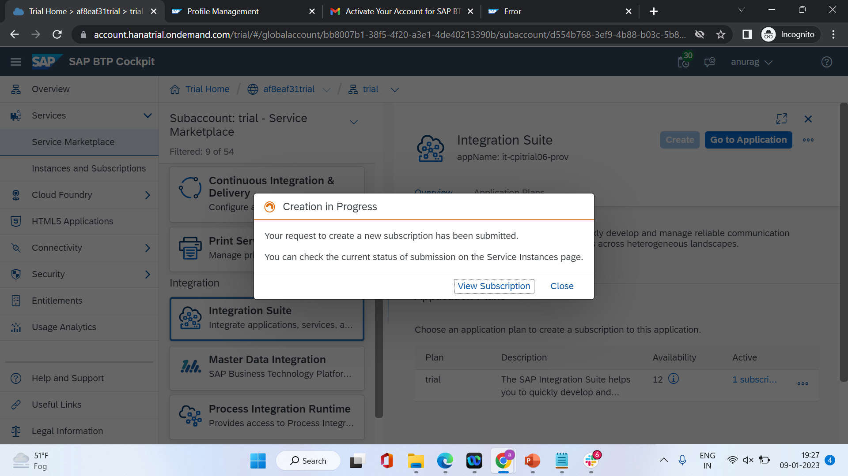

Slide 46
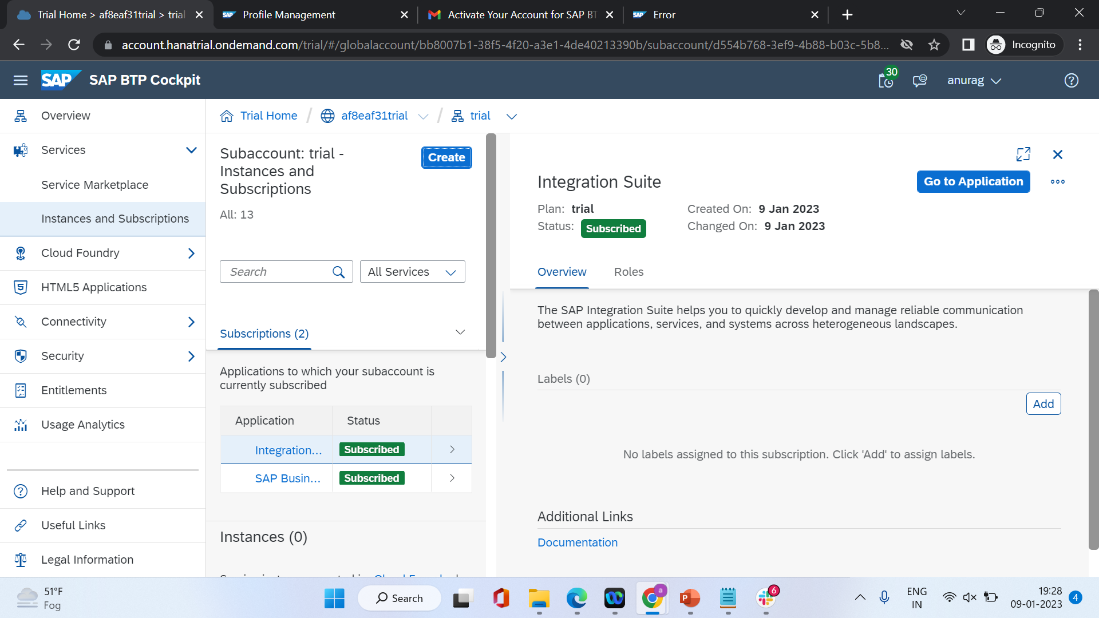

Slide 47
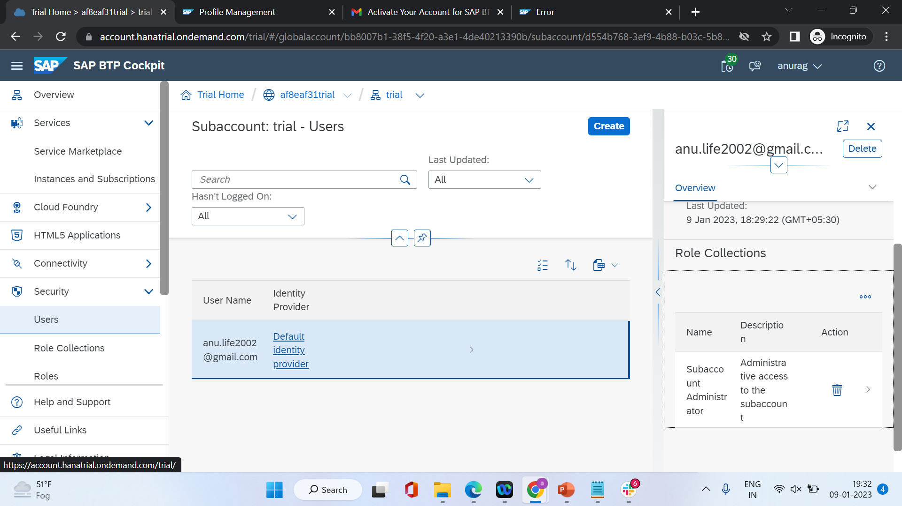

Slide 48
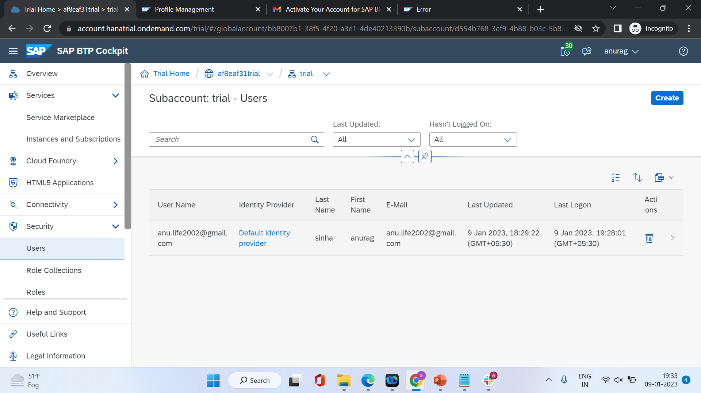

Slide 49
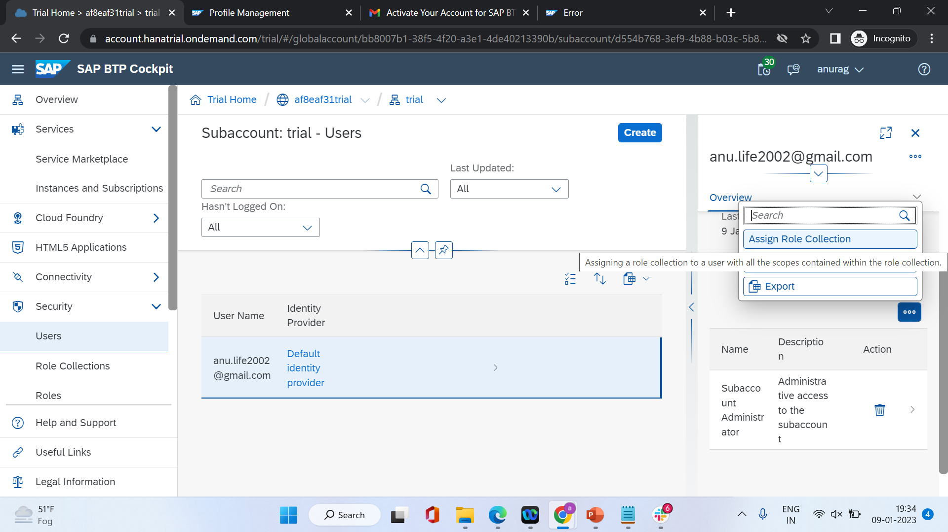

Slide 50
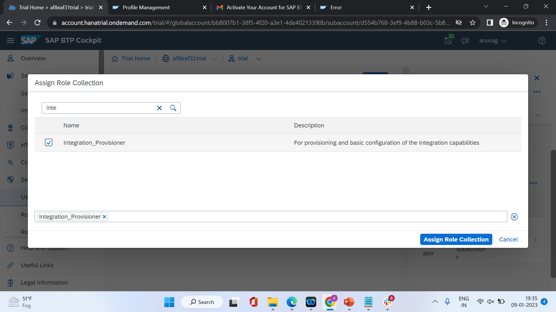

Slide 51
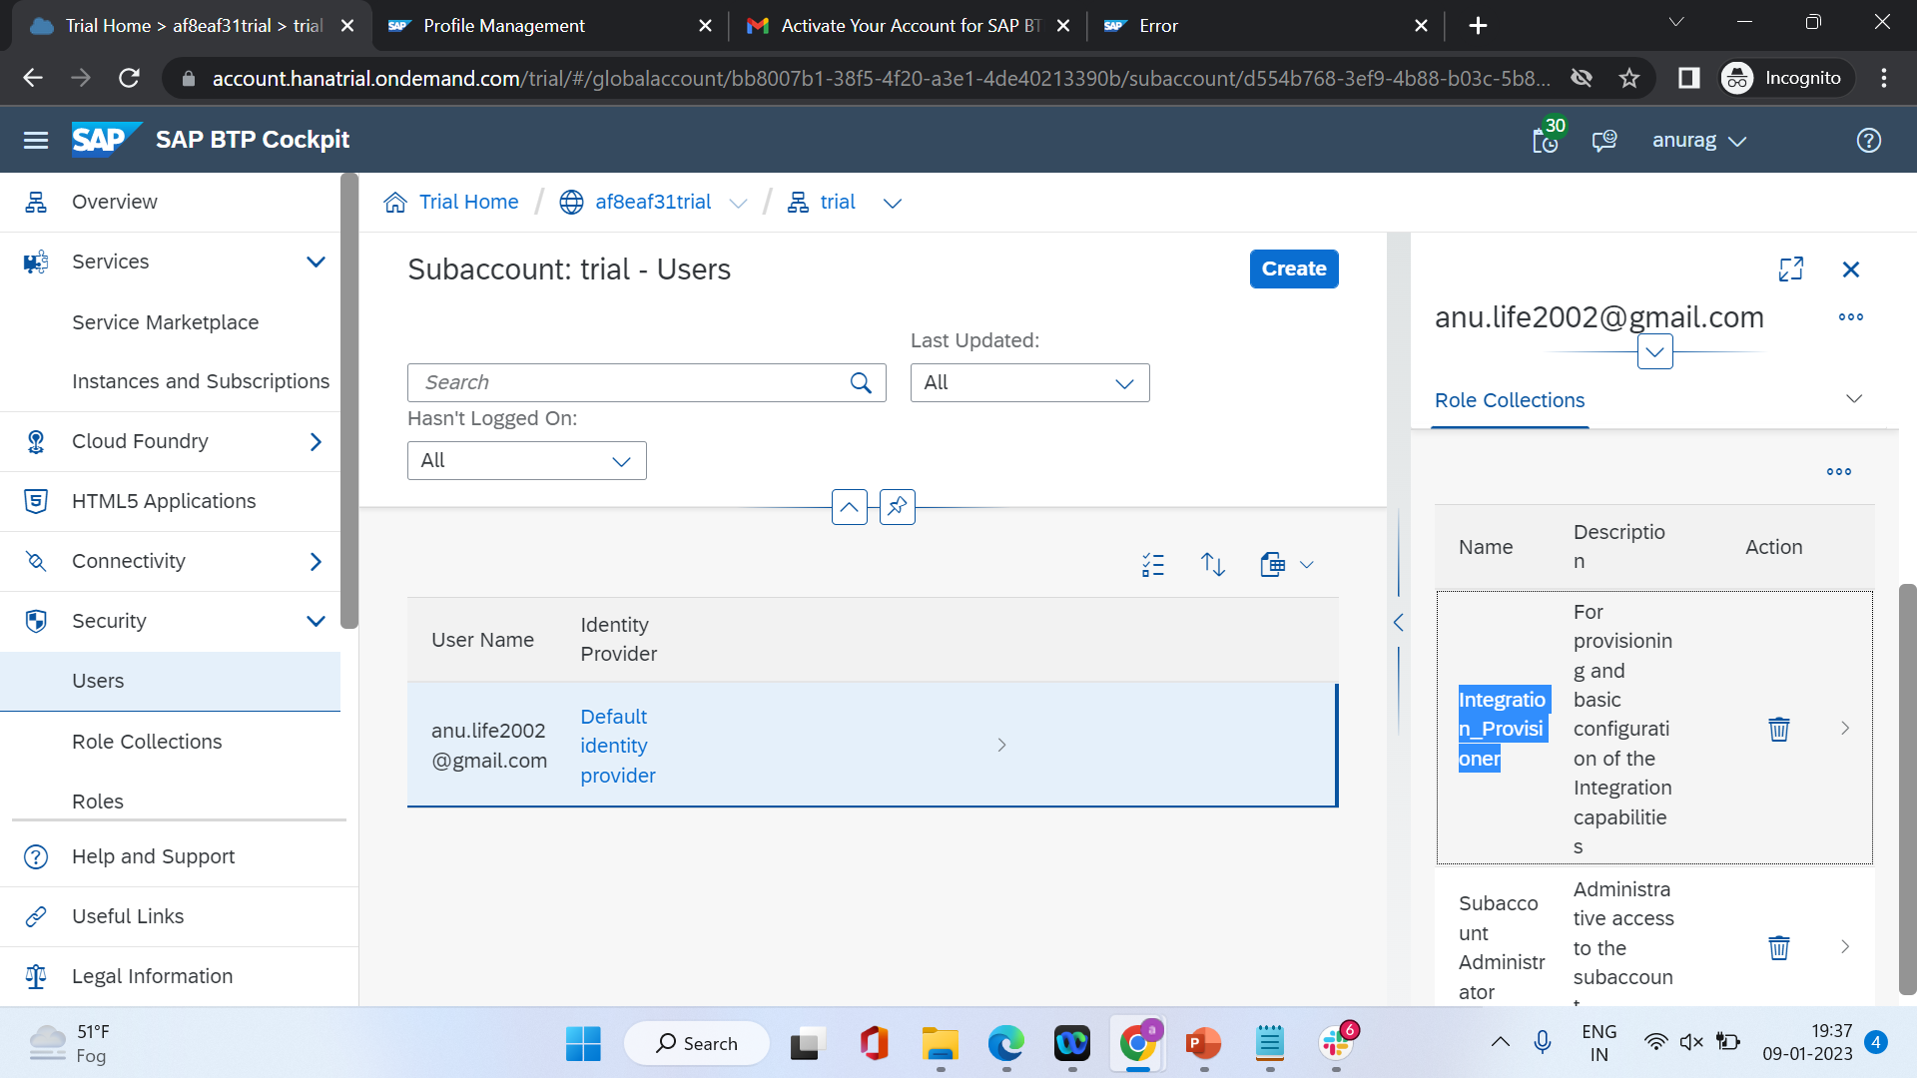

Slide 52
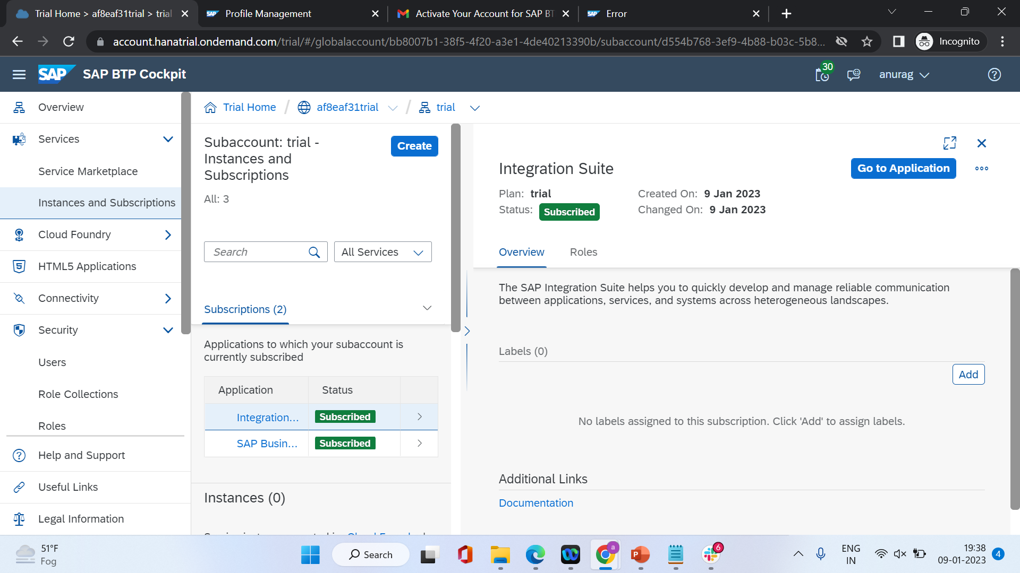

Slide 53
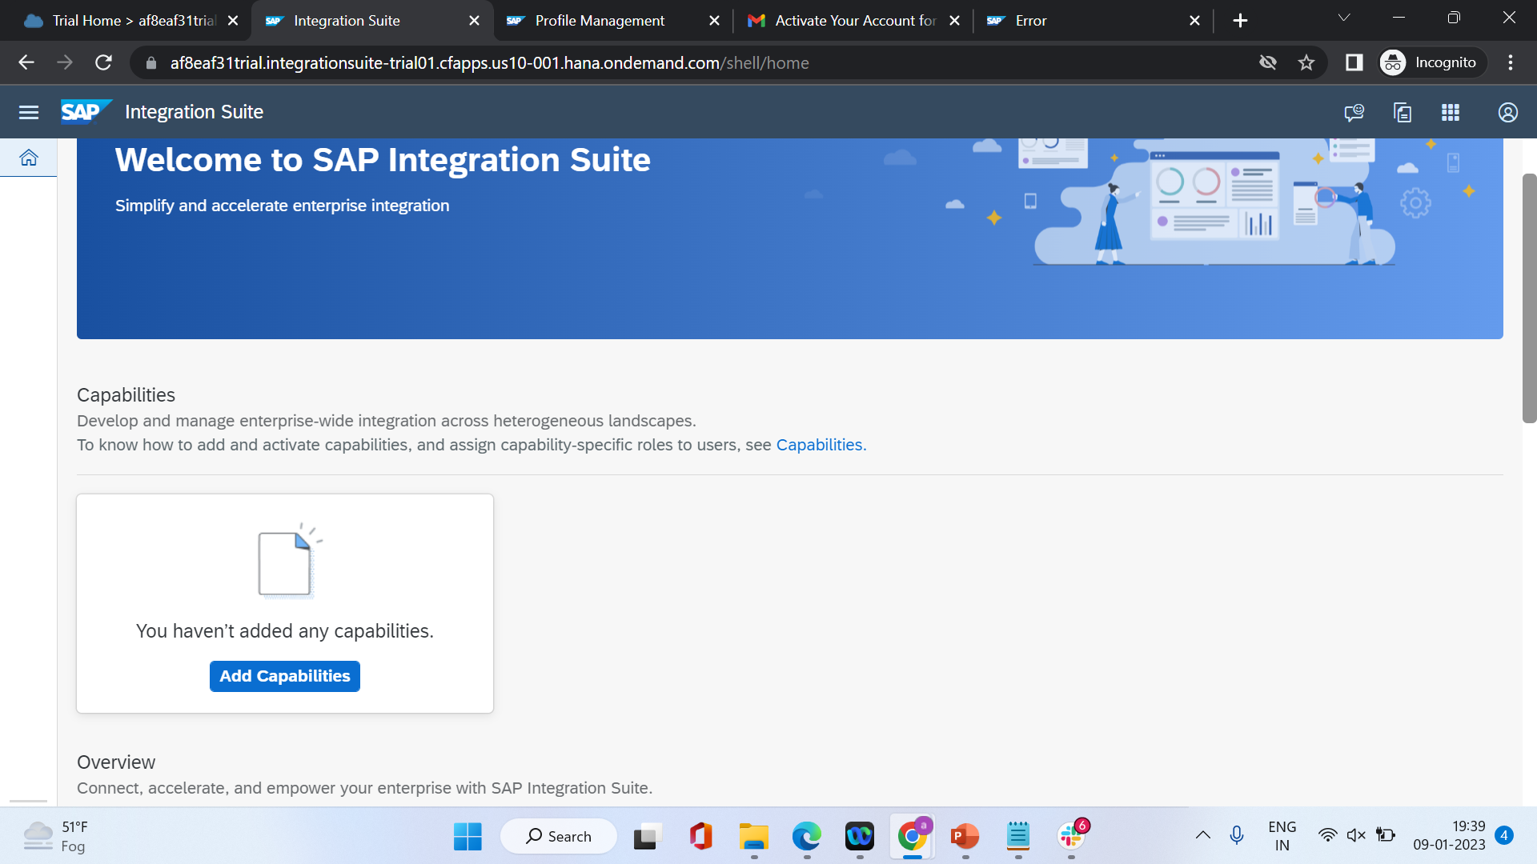

Slide 54
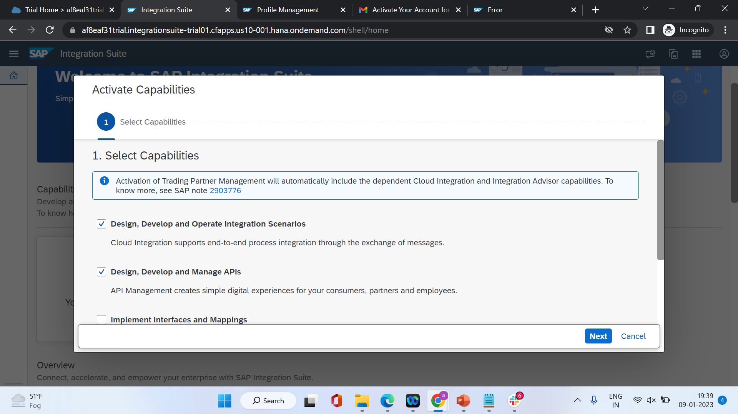

Slide 55
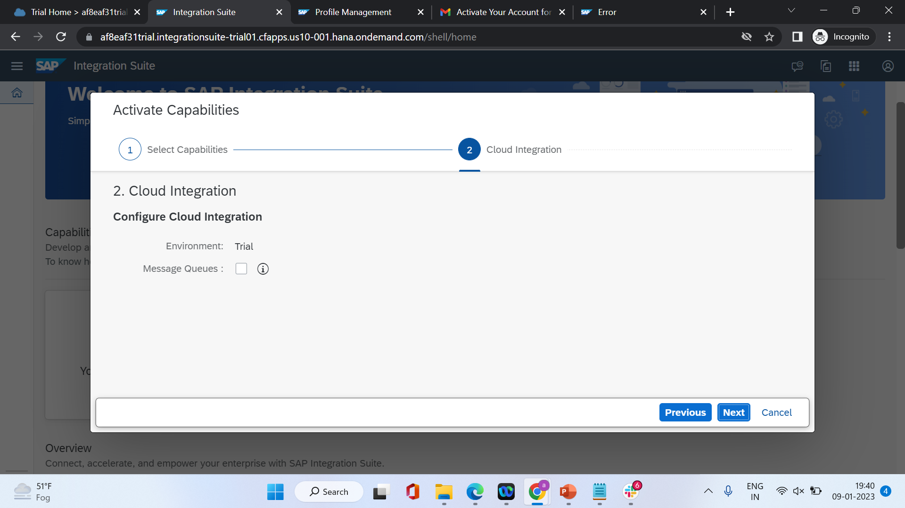

Slide 56
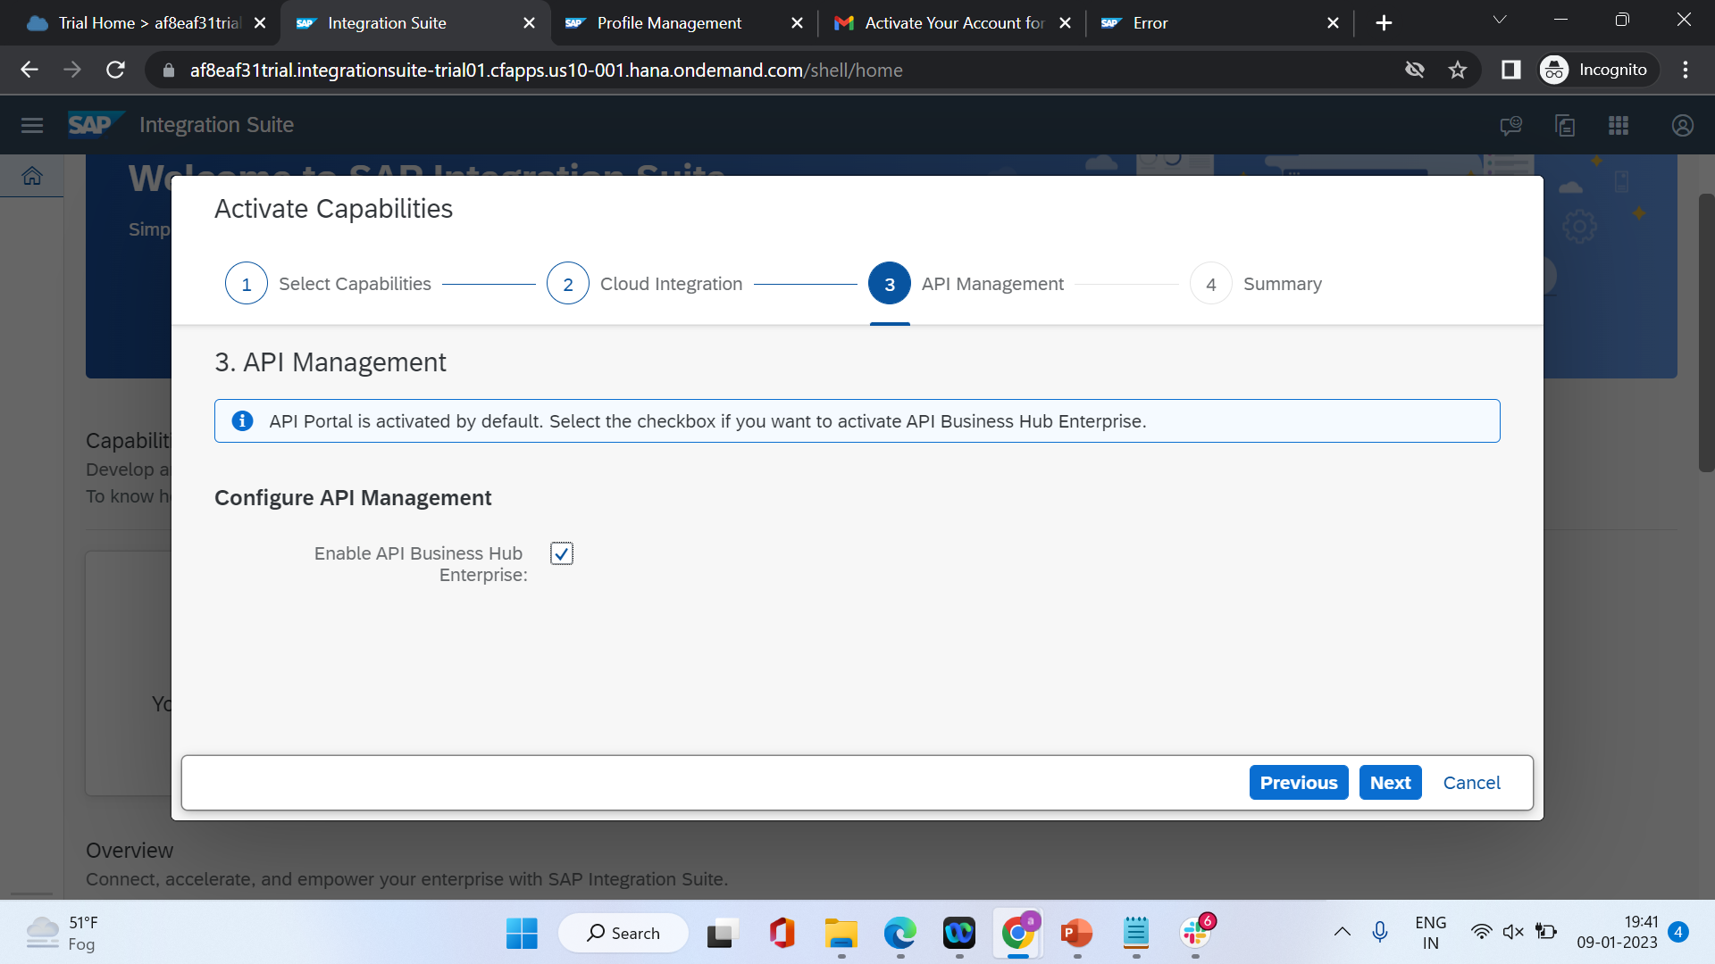

Slide 57
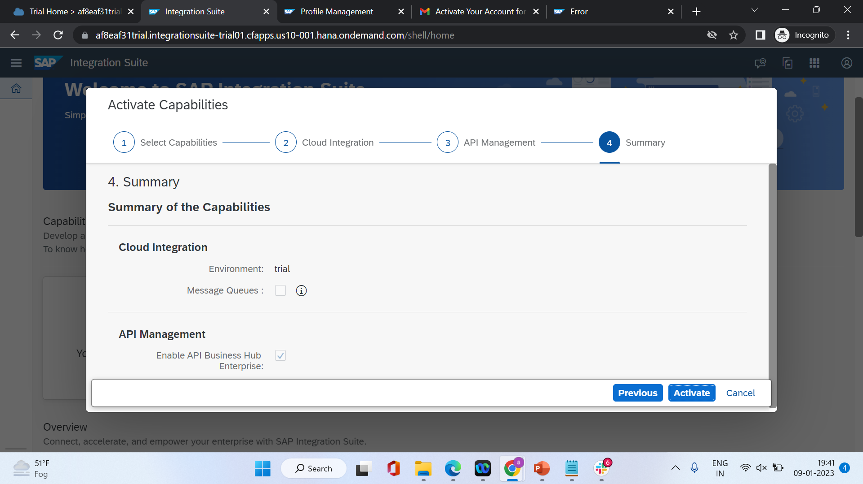

Slide 58
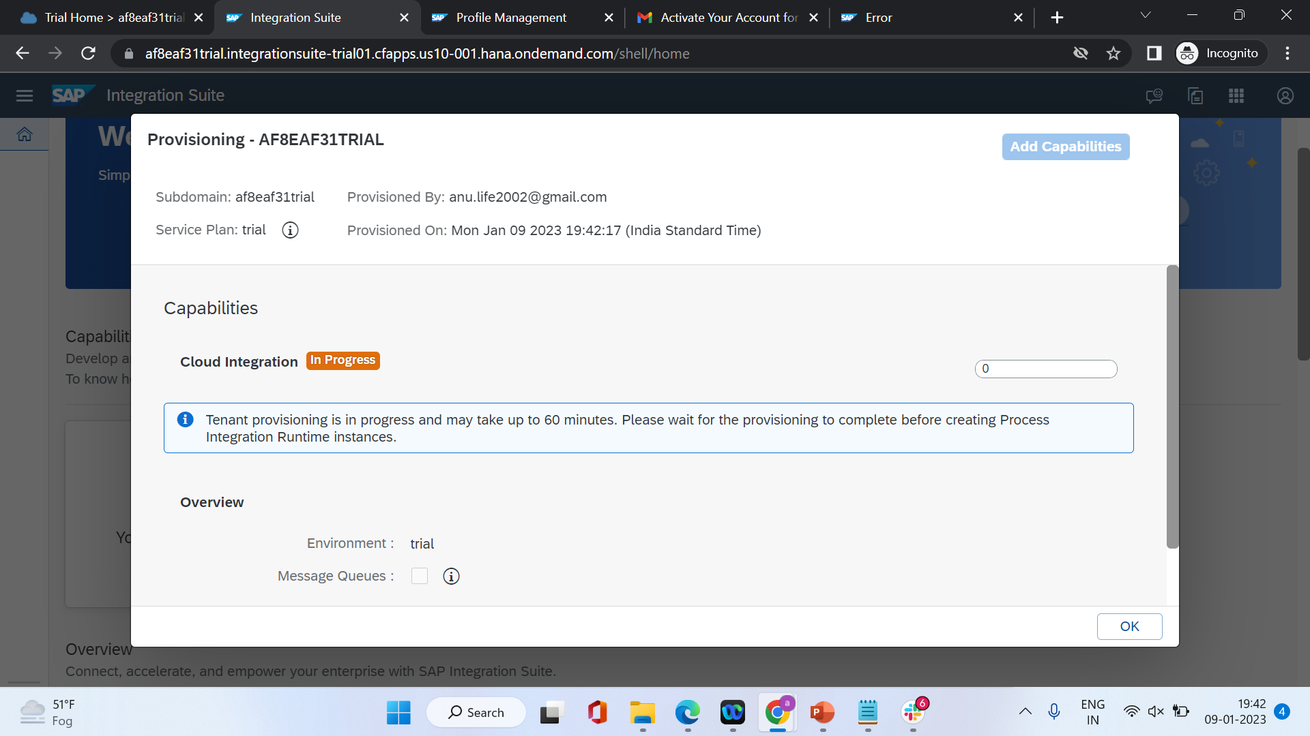

Slide 59
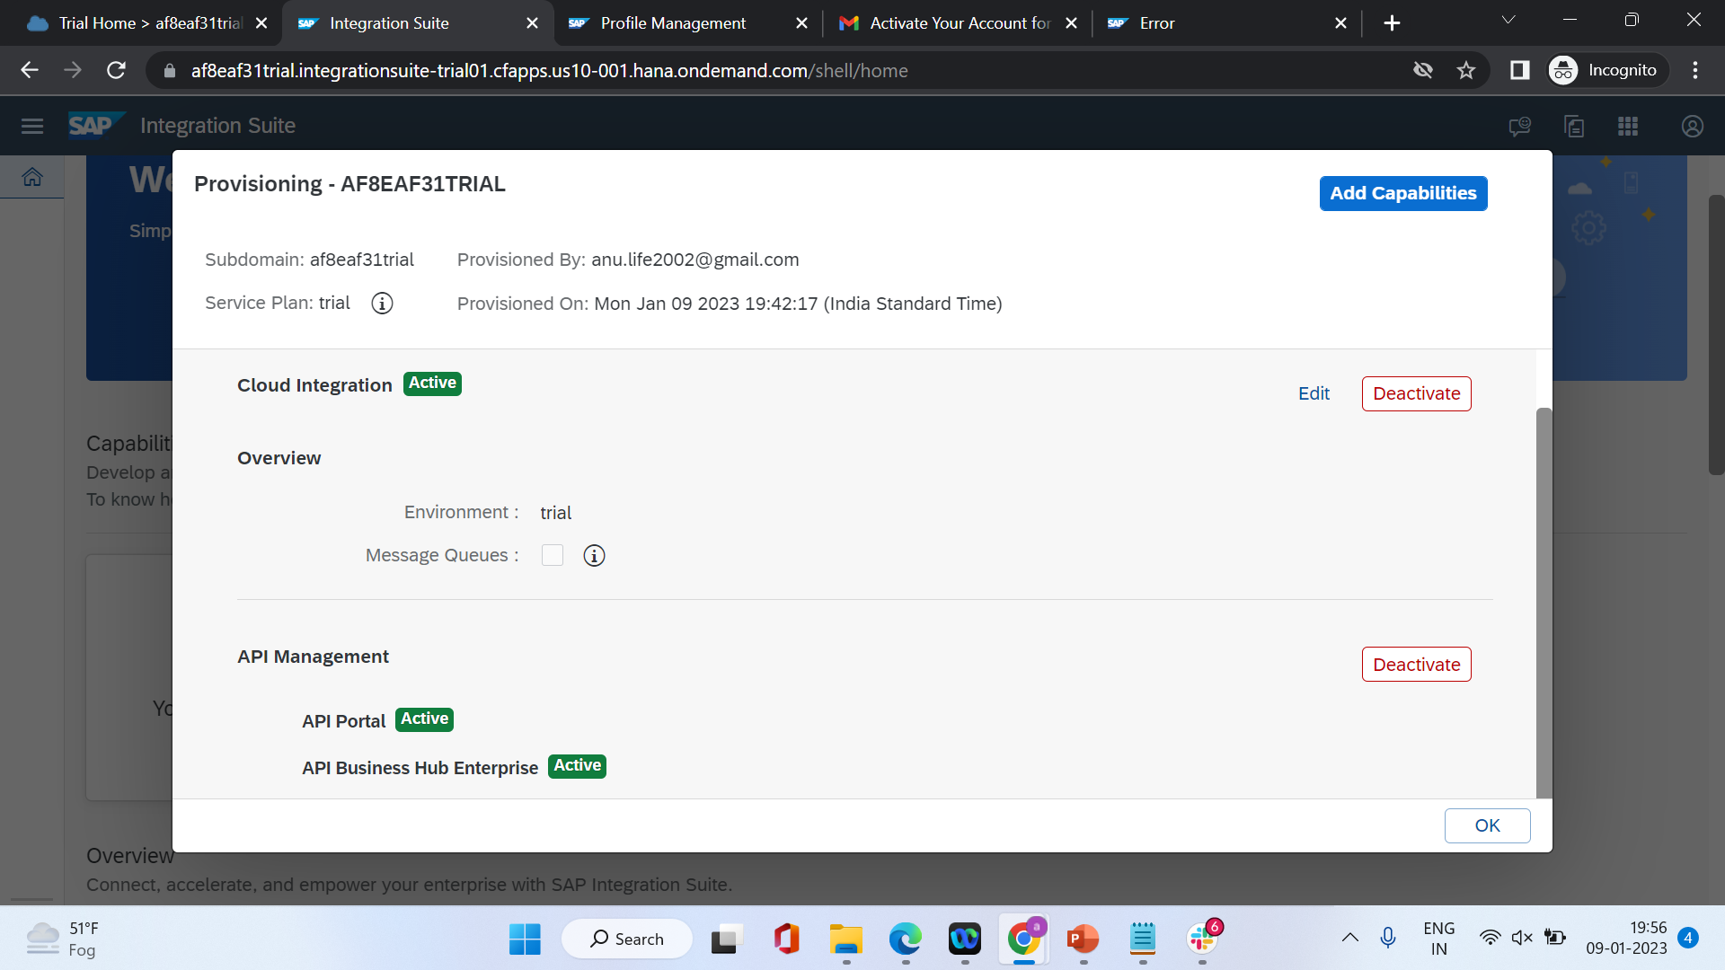

Slide 60
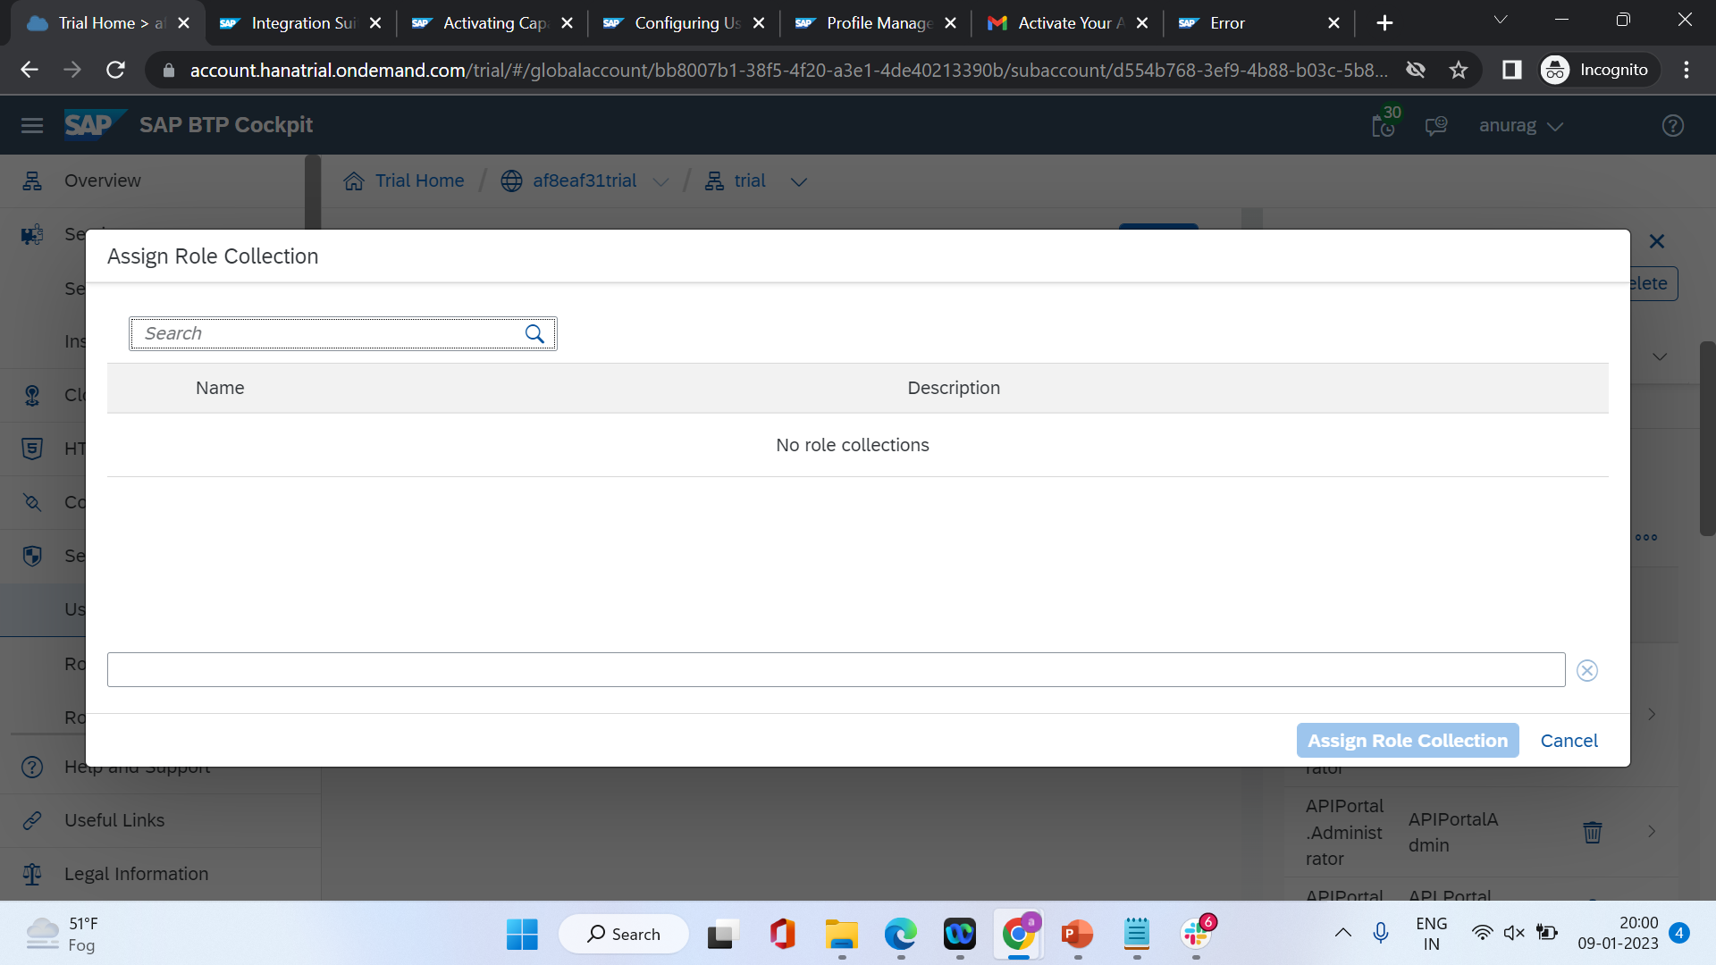
Assign all roles to view CI

Slide 61
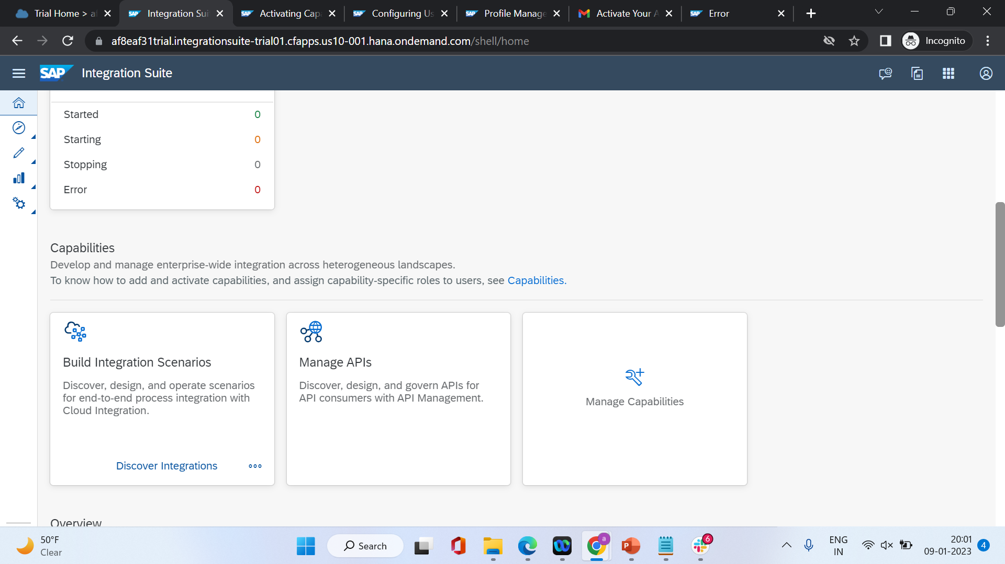

Slide 62
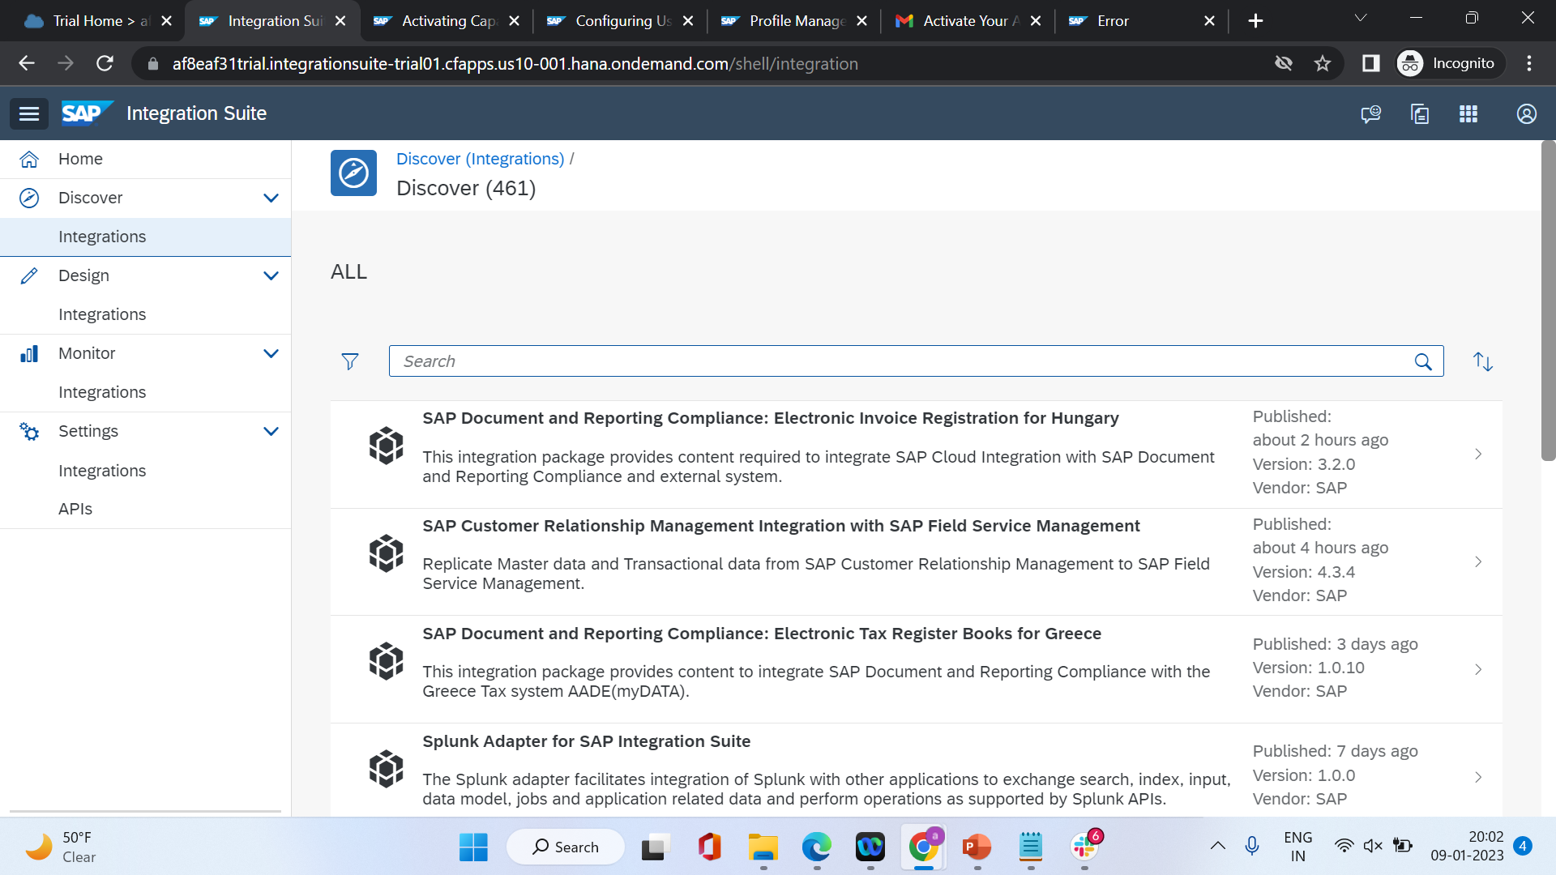
Anu.life2002@gmail.com
Mobile@123
https://af8eaf31trial.integrationsuite-trial01.cfapps.us10-001.hana.ondemand.com/shell/integration

Slide 63
BOOSTER setup

Slide 64
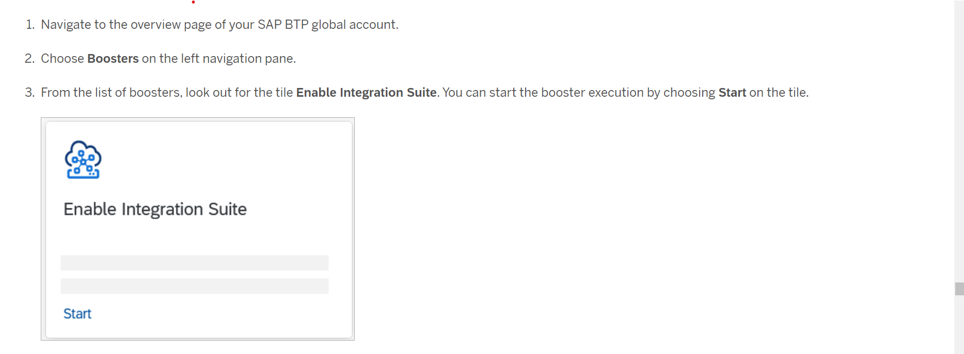

Slide 65


Slide 66


Slide 67

Summarize
LET’S SUMMARISE!

Slide 68

Summarize
End of Day 1

Slide 70


We’re committed to empower you to be
#FutureReady
through powerful training solutions.
We build the workforce of the future.
250+
Corporate Clients
30,000+
Learners Trained
25000+
Learners Placed
FREE WEBINARS
Sign up for free webinars with industry experts every fortnight!
Enroll Now!
Contact us today!
https://anubhavtrainings.com

